Slide 1
BRICK BREAKER
Break it to win it!!

Slide 2
What is this game about?
Brick breaker is an arcade game.
Each level composes of different kinds of bricks with different layouts.
Aim: The player should control the paddle which prevents the ball from falling off the screen(playing area) in turn attempting to hit the bricks with the help of the bouncing ball.
Ball striking the brick causes the brick to break and eventually disappear depending on the hit points of the brick.
When all the bricks disappear, the player proceeds to next level which will have different kind(pattern) of bricks.

Slide 3
Character Design
Object oriented programming concepts will be used to create different kinds of bricks in different levels.
Ball and the paddle will be created with the help of physics
Collision concepts will be implemented to detect collision between:
Ball and bricks
Ball and paddle.
Composer Scenes is used for transition from level to another.

Slide 4
Target audience
Children between age 8-12 years

Slide 5
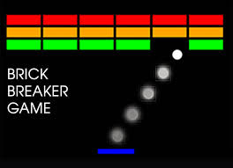
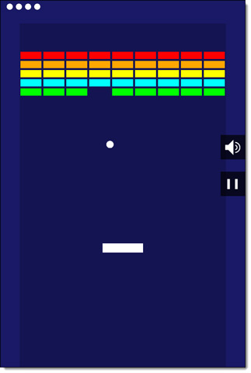
Screenshots

Slide 6
Scoring System and Acheivements
Each time the balls goes off the playing area, the life of the player is decremented by 1
When the life reaches zero, the game is over.
There is a hit point assigned to bricks in each level, the hitpoints of the brick increases as the user progresses to the next level.
Hitpoint of the brick is decremented by 1 each time the ball strikes the brick.
When the hitpoint of the brick reaches zero, the brick is removed from the play area.

Slide 7
Target platform
Handheld and Mobile devices(Android)
Input technology:
Touch screen gestures (pan)
Simulator: Corona Sdk

Slide 8
References
https://en.wikipedia.org/wiki/Arkanoid
http://www.gamasutra.com/view/feature/1630/breaking_down_breakout_system_and_.php?print=1

